Slide 1
Configuring MS Visual C++ for Parser Generator 2
Novia Nurain

Slide 2
Setup activities for working with MS Visual C++
This tutorial shows step up process for version Visual C++ Version 6.
Setup MS Visual C++
Setup of the directories options (you’ll need to perform them once),
Setup for each project.

Slide 3
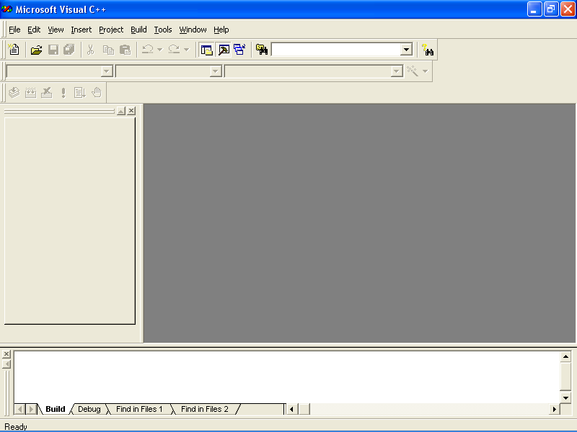

Slide 4
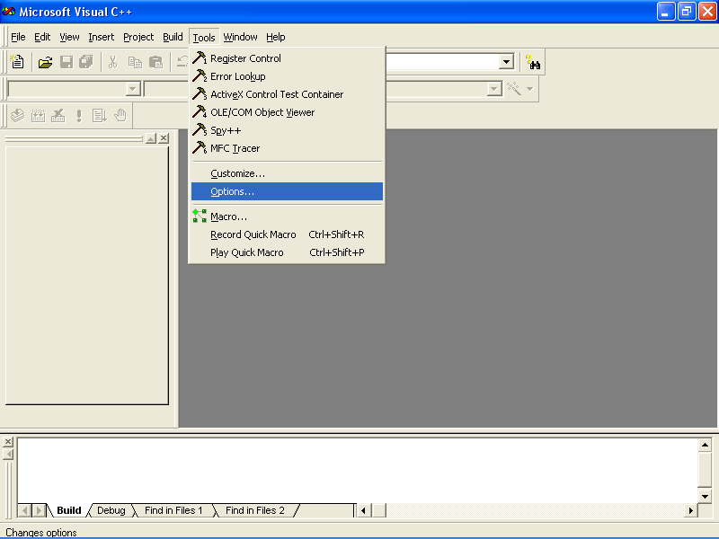

Slide 5
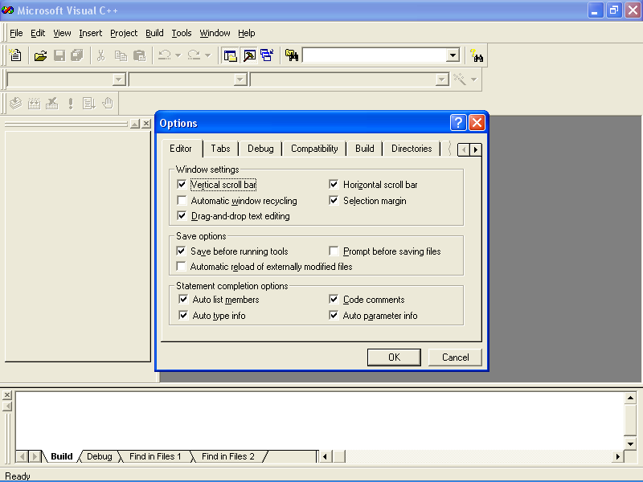

Slide 6
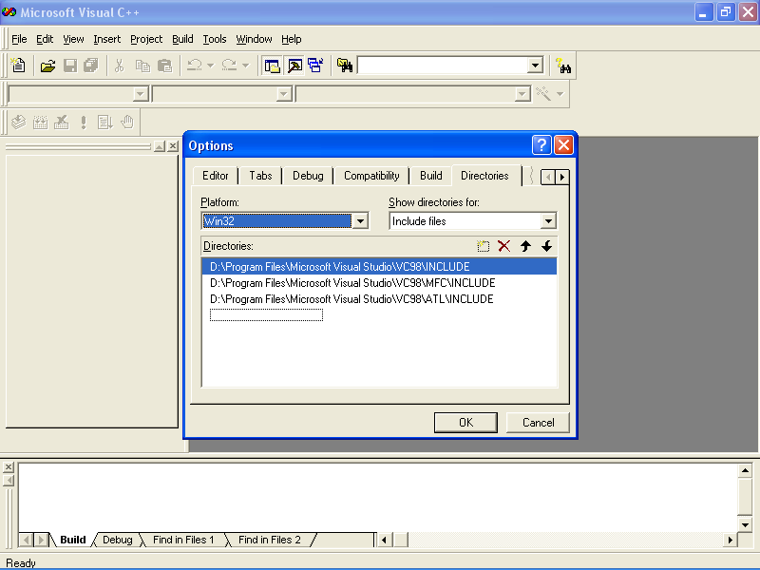

Slide 7
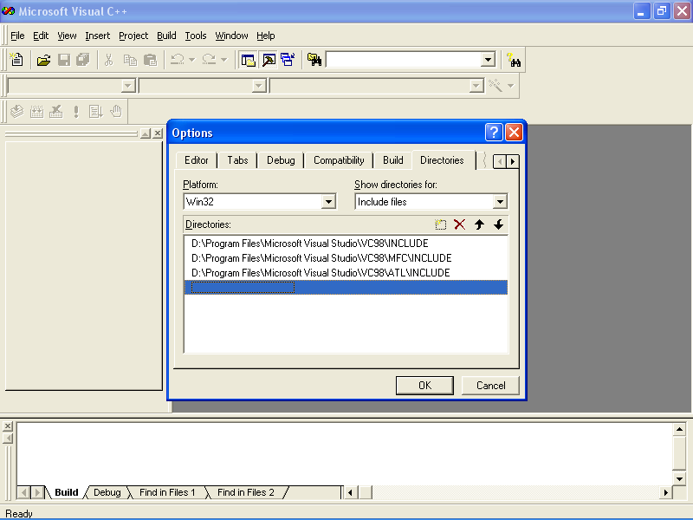

Slide 8
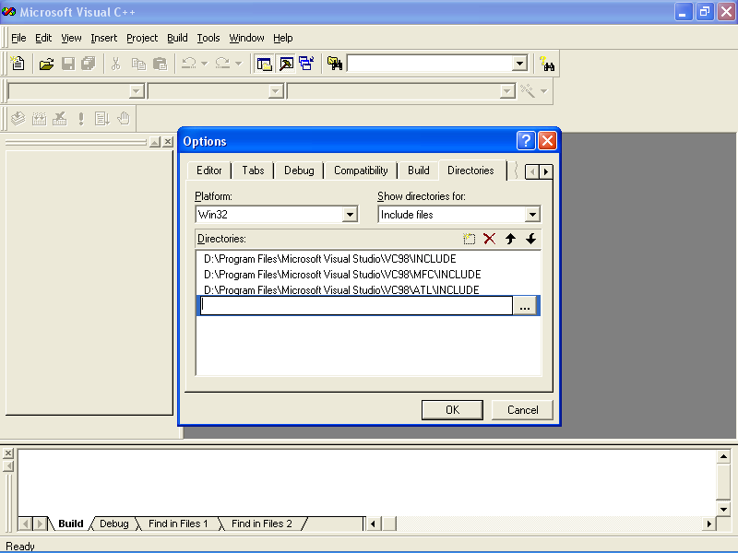

Slide 9
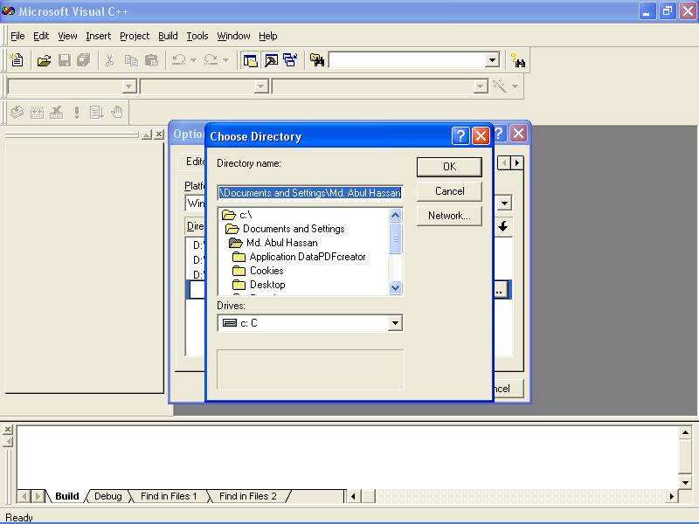

Slide 10
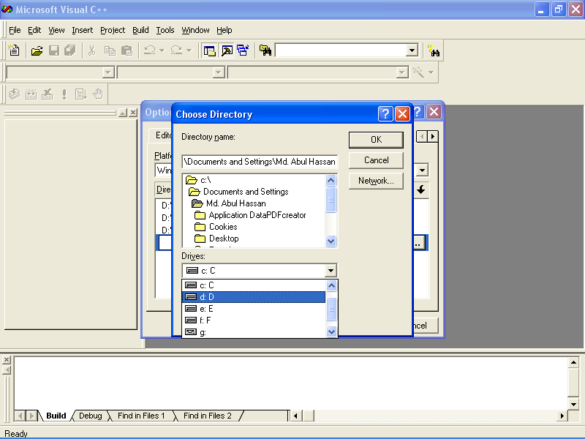

Slide 11
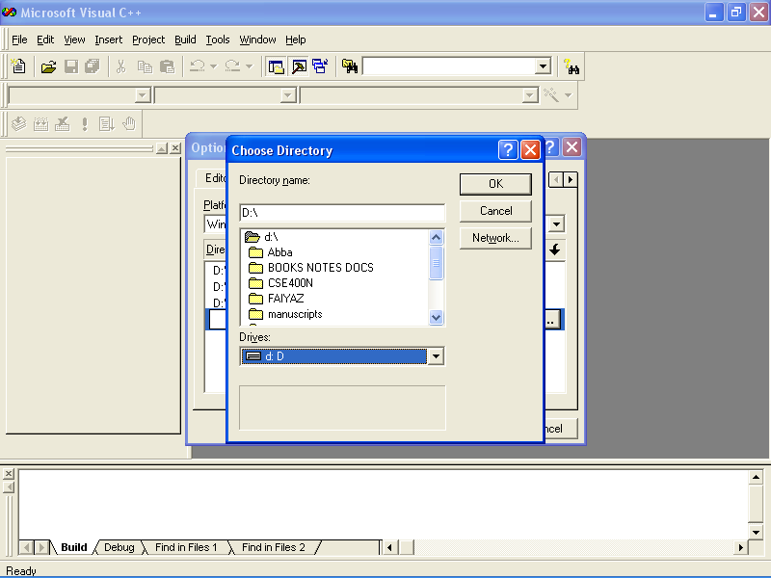

Slide 12
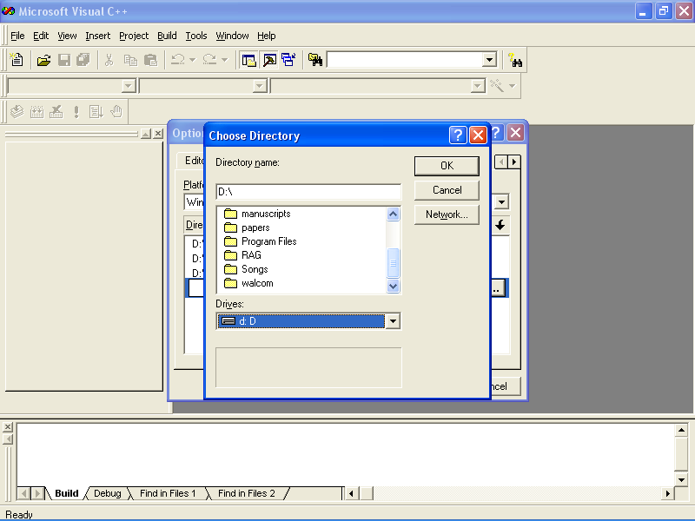

Slide 13
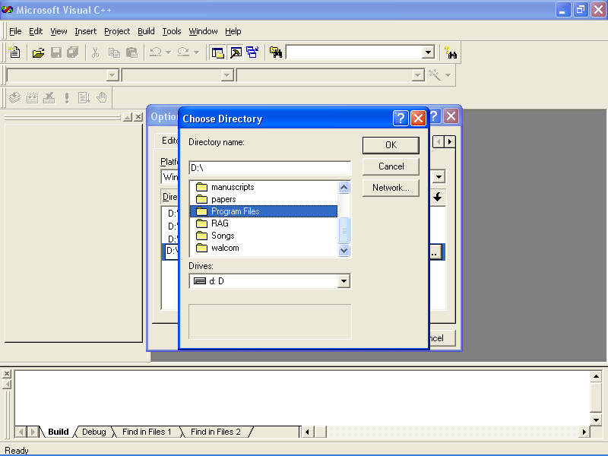

Slide 14
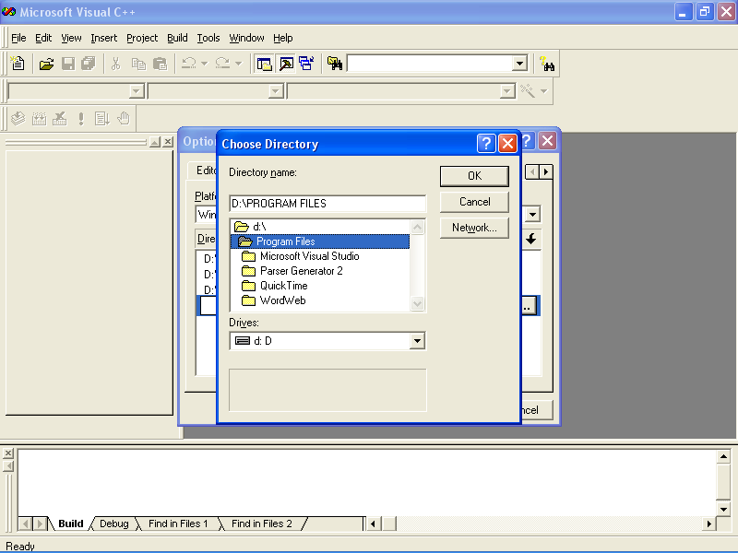

Slide 15


Slide 16
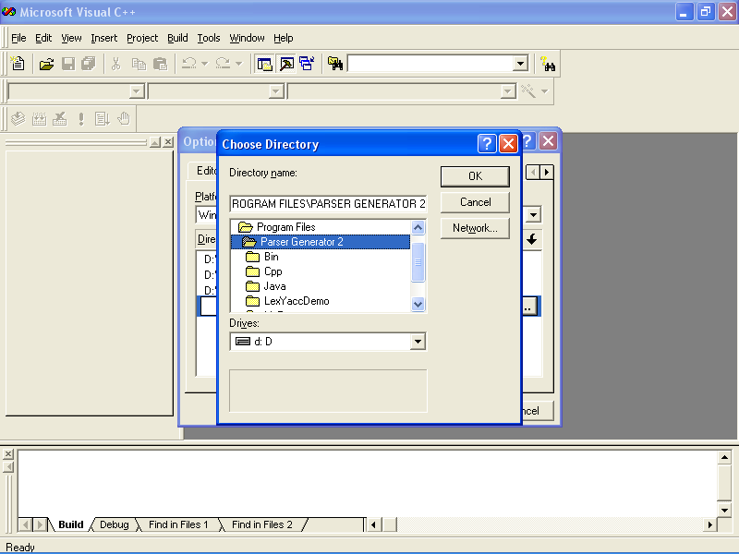

Slide 17


Slide 18
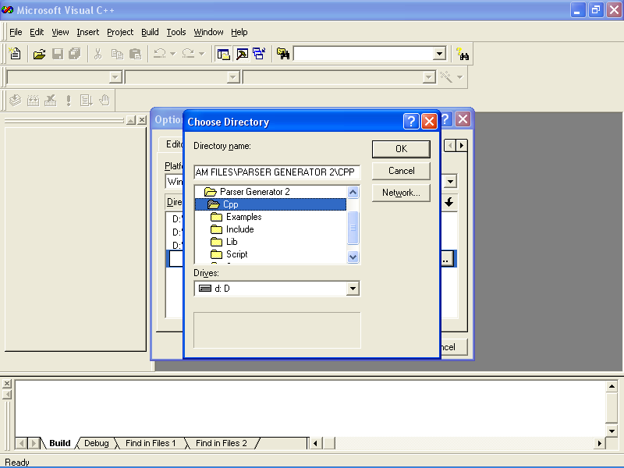

Slide 19


Slide 20
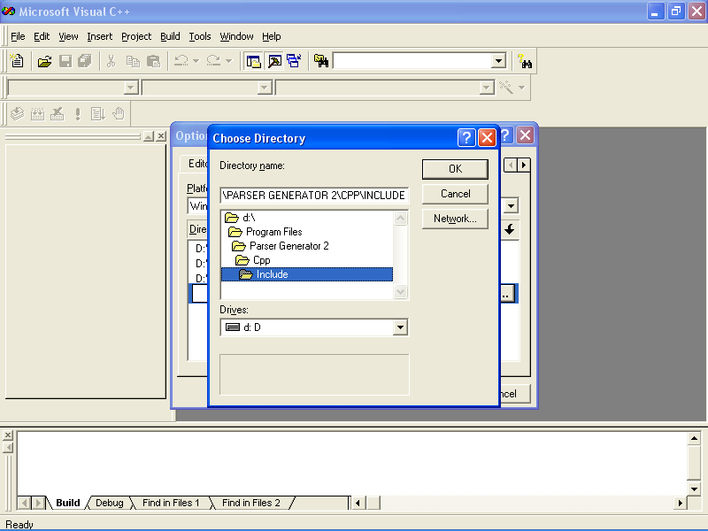

Slide 21
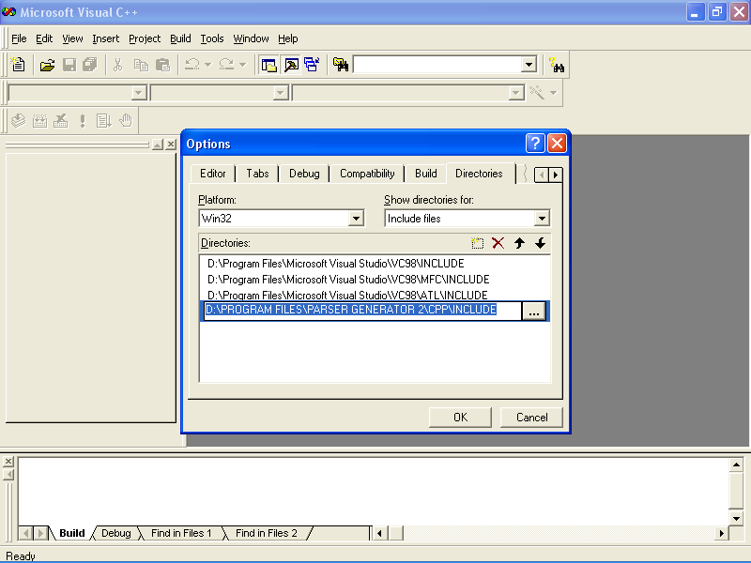

Slide 22
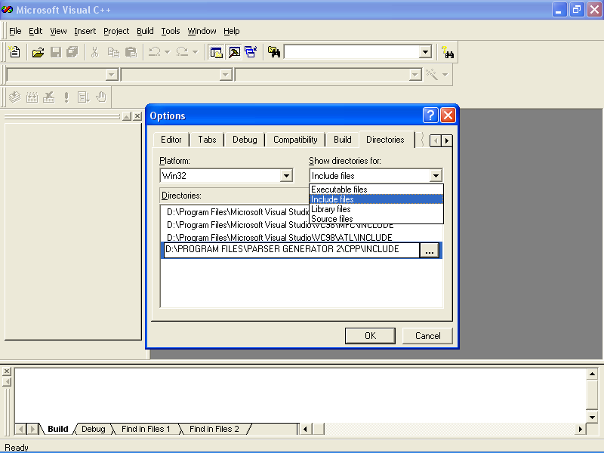

Slide 23
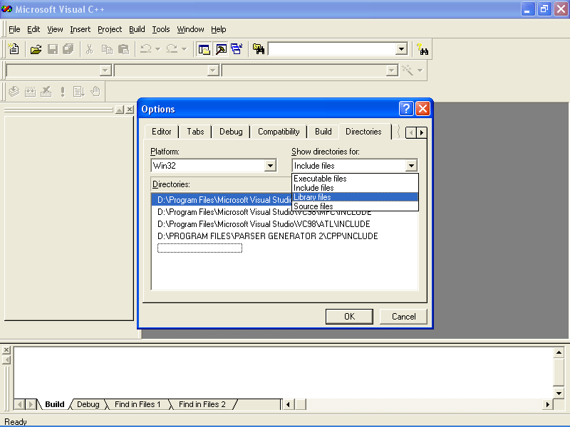

Slide 24
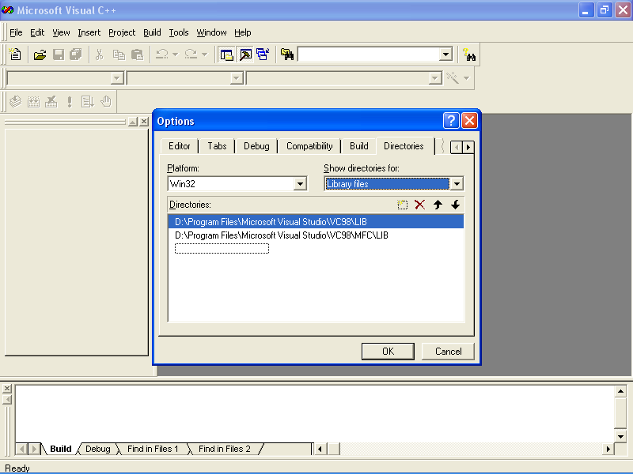

Slide 25
Similar to the way you set your “include” directory ...

Slide 26
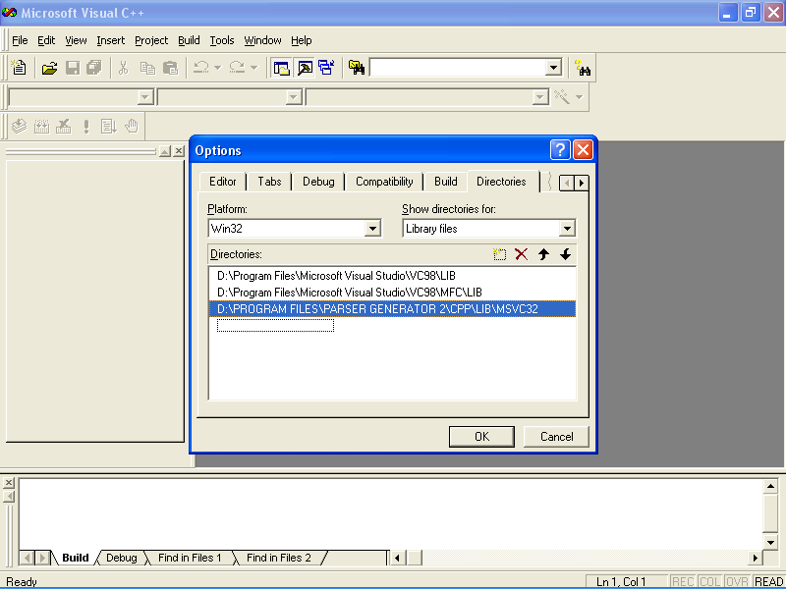

Slide 27
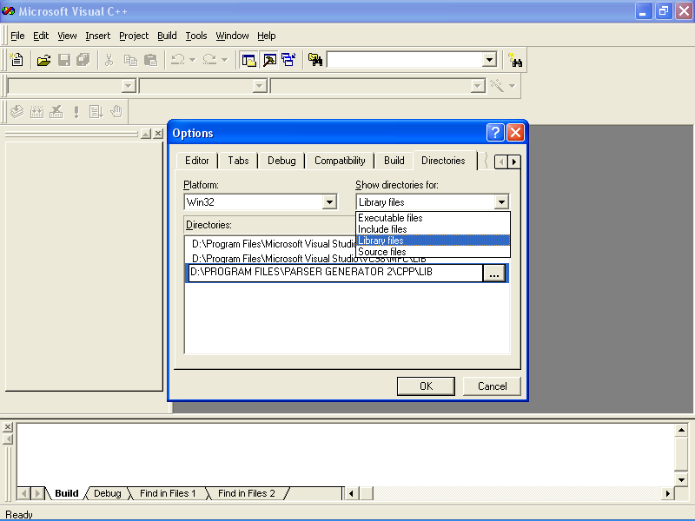

Slide 28
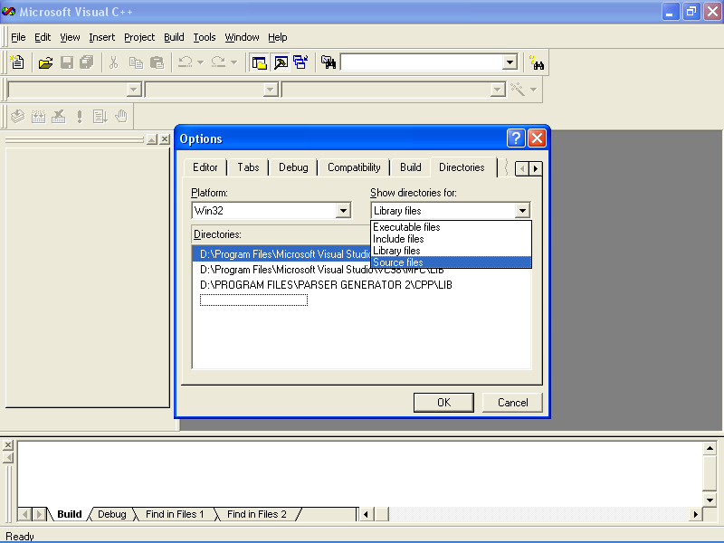

Slide 29
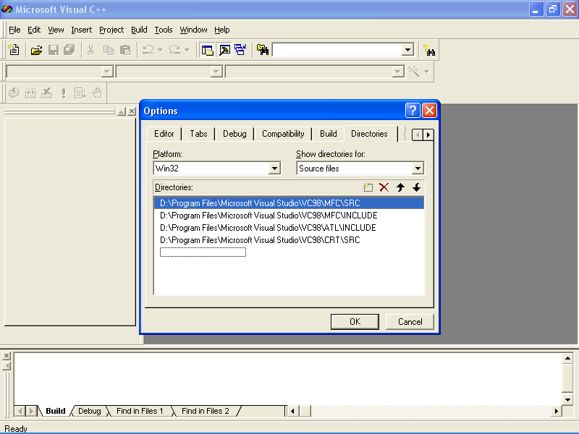

Slide 30
Similar to the way you set your “include” & “libraries”directory ...

Slide 31
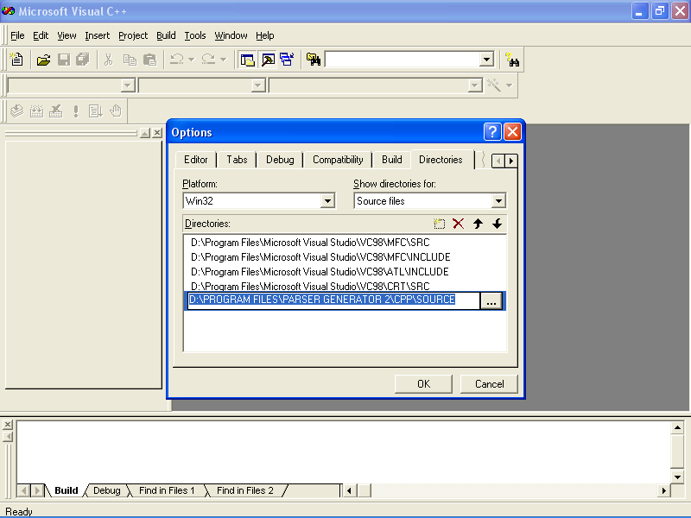

Slide 33
Working with Parser Generator
We will cover only the Lex part in this tutorial

Slide 34
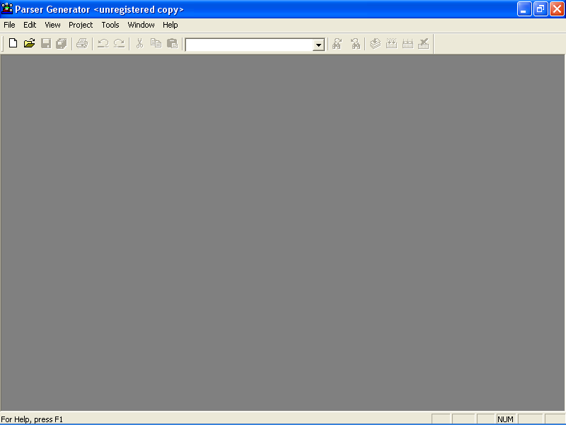

Slide 35
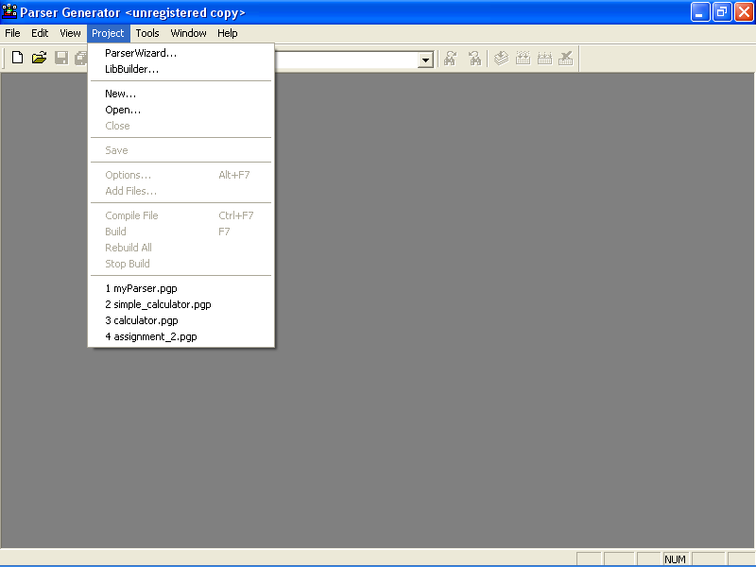

Slide 36
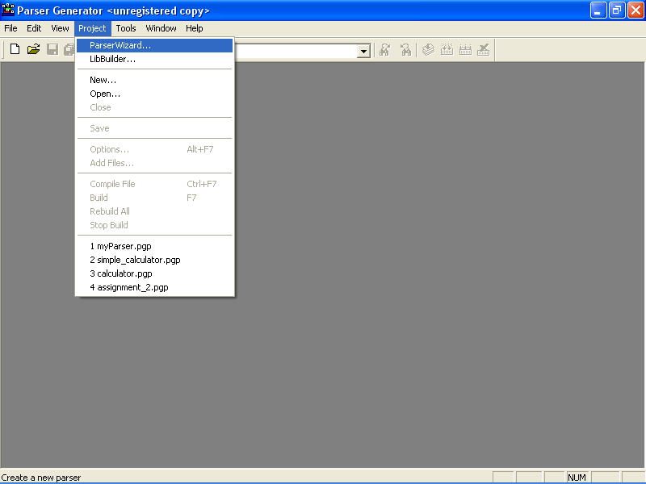

Slide 37
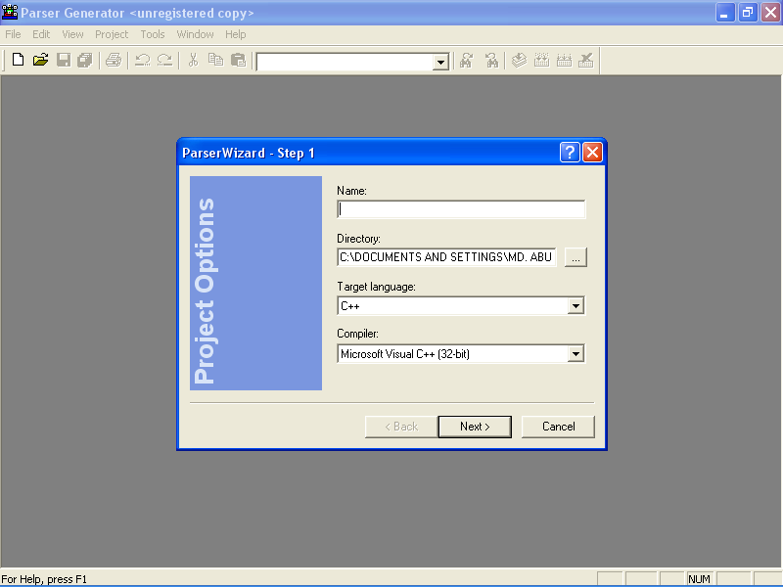

Slide 38
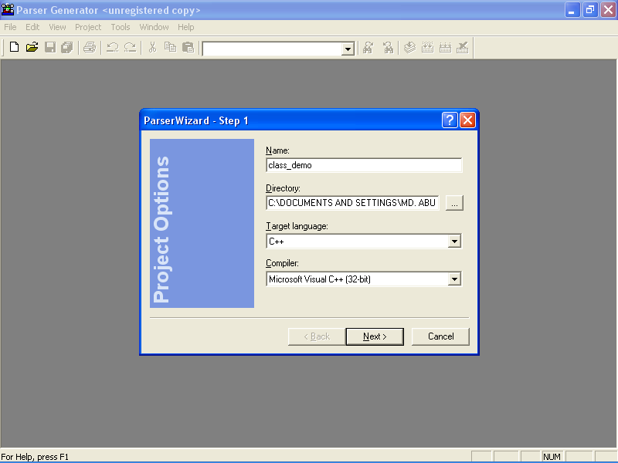

Slide 39
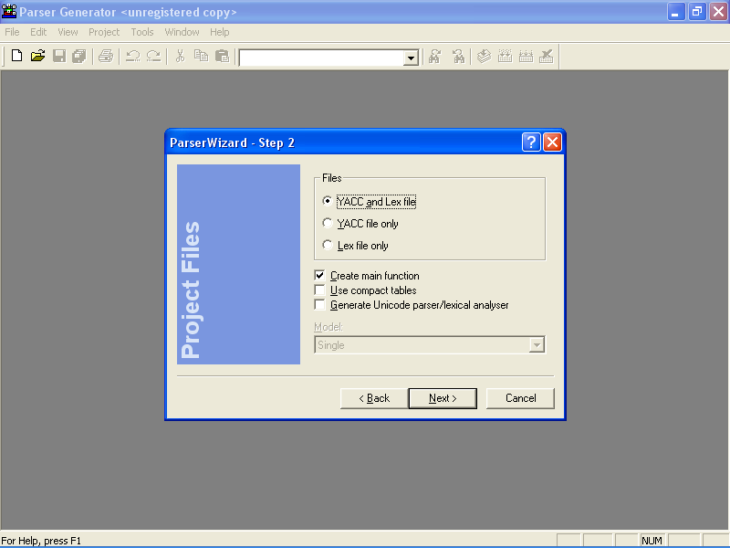

Slide 40
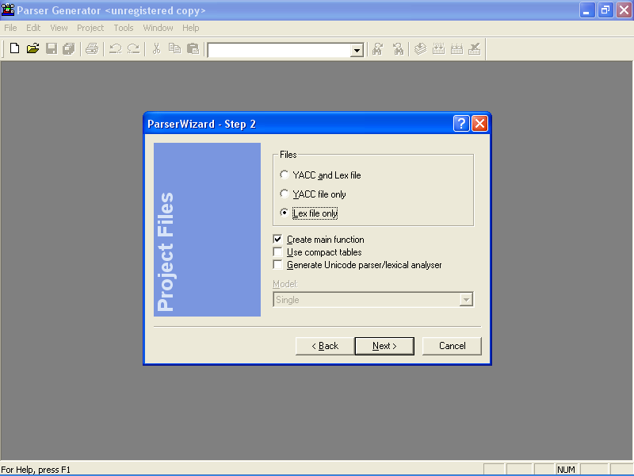

Slide 41
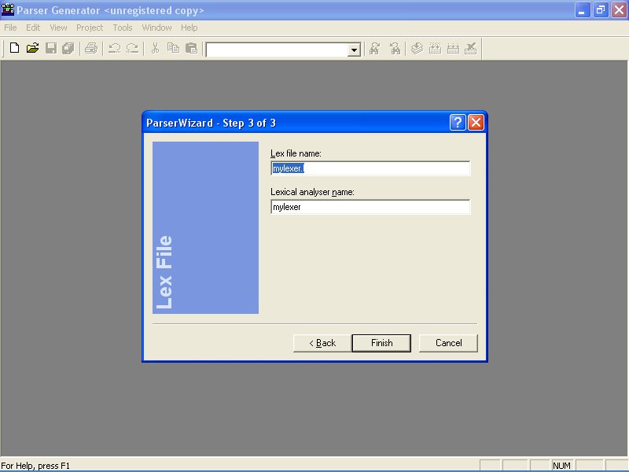

Slide 42
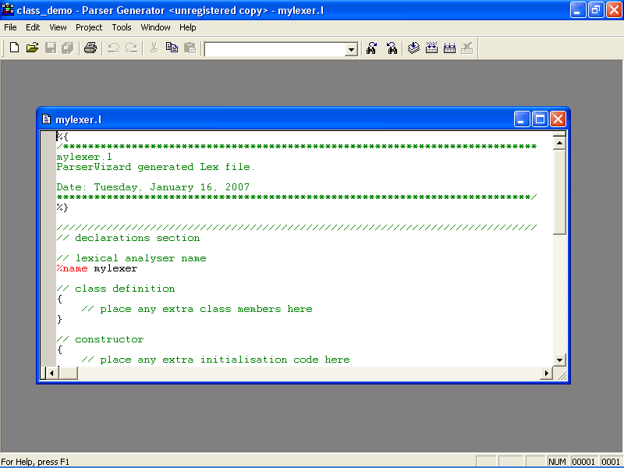

Slide 43
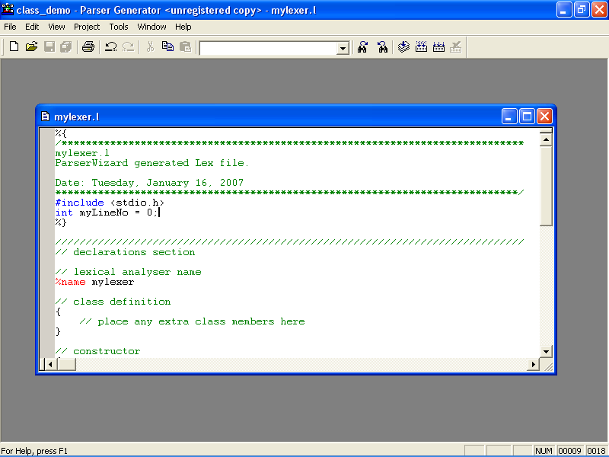

Slide 44
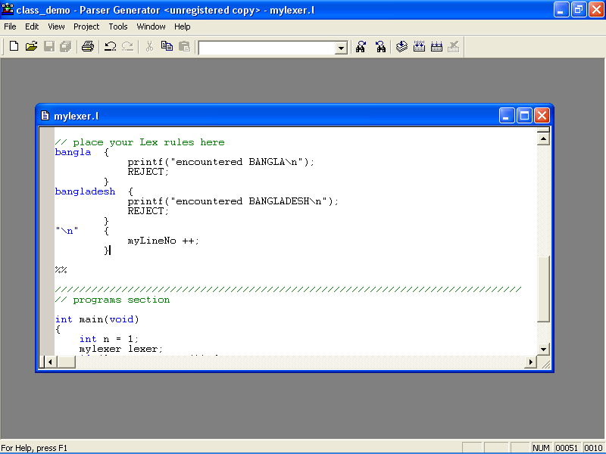

Slide 45
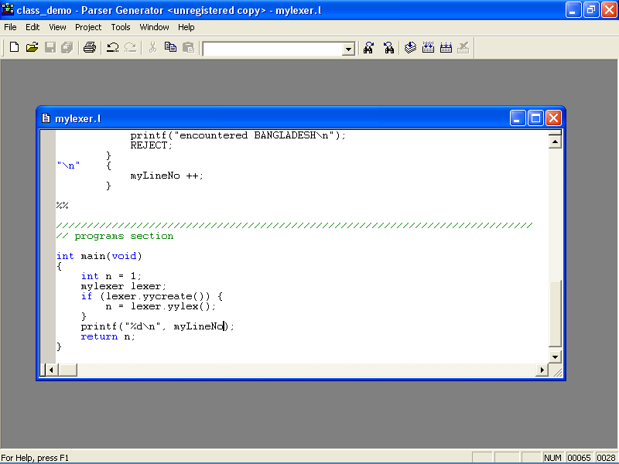

Slide 46
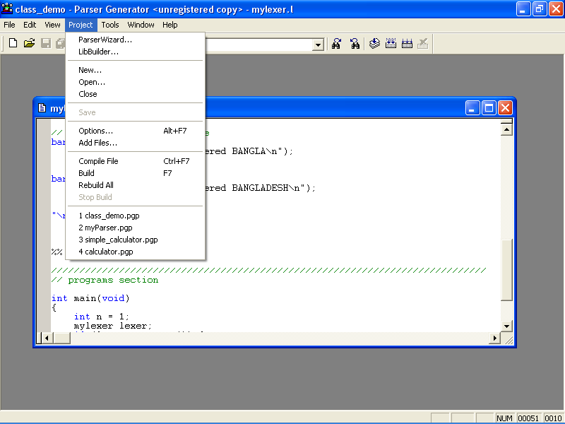

Slide 47
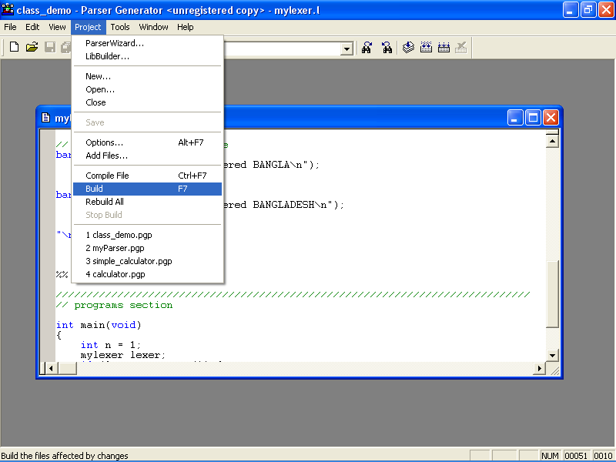

Slide 48
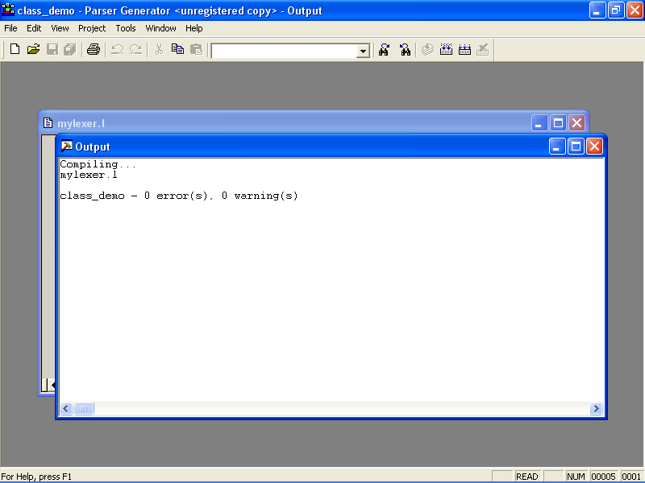

Slide 49
Open a new Win32 Console Application project in Visual C++

Slide 50
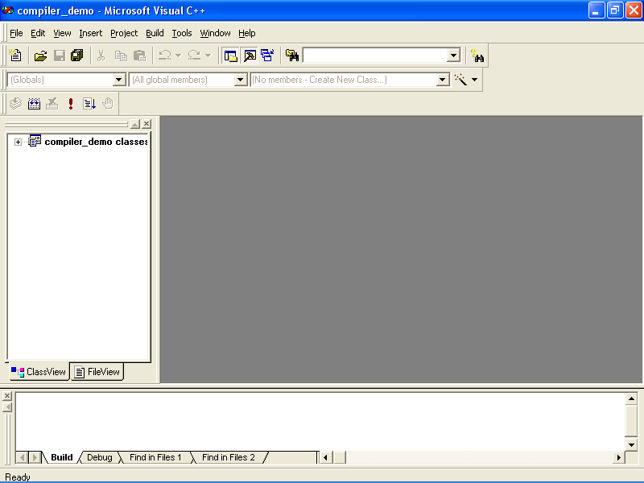

Slide 51
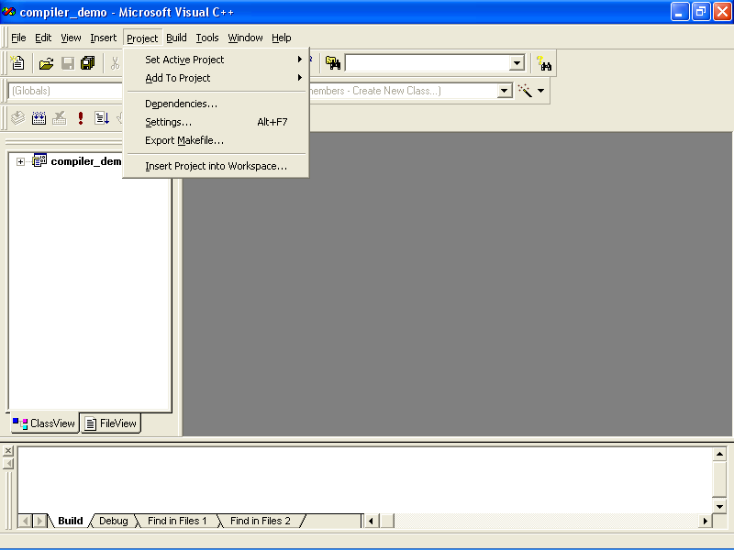

Slide 52
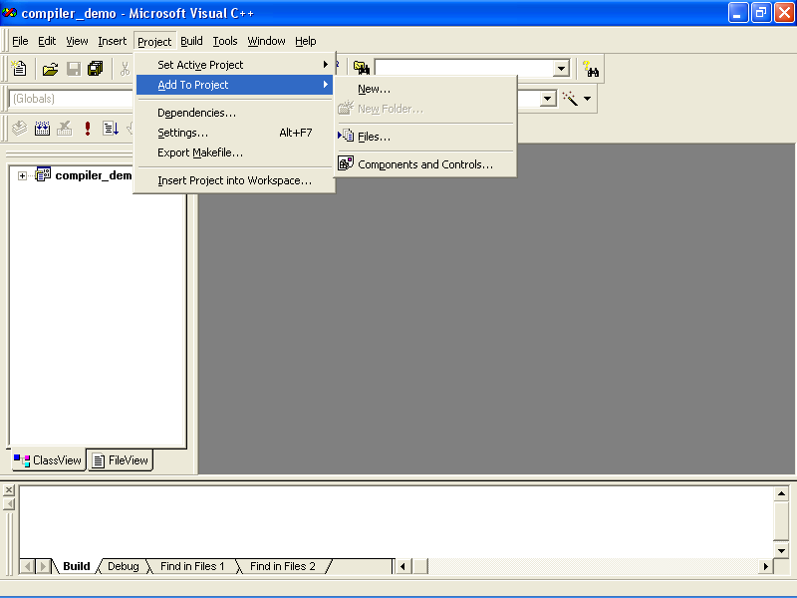

Slide 53
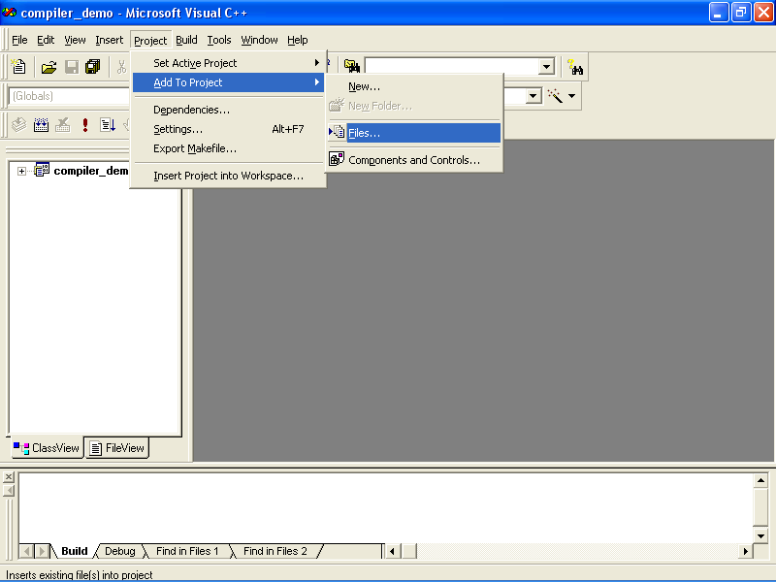

Slide 54
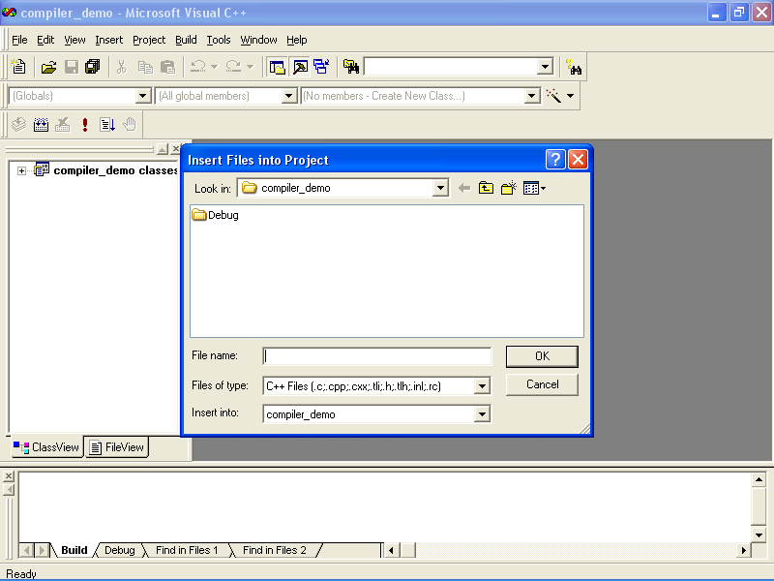

Slide 55
Now you select the folder containing your Parser Generator Project

Slide 56
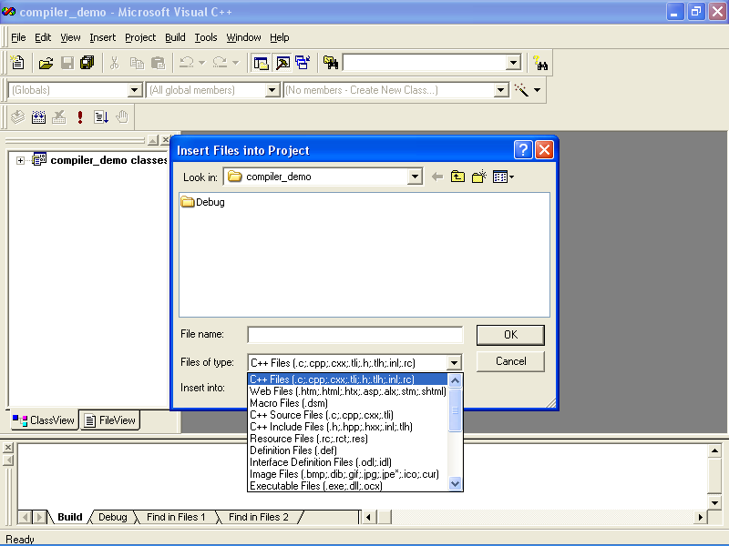

Slide 57
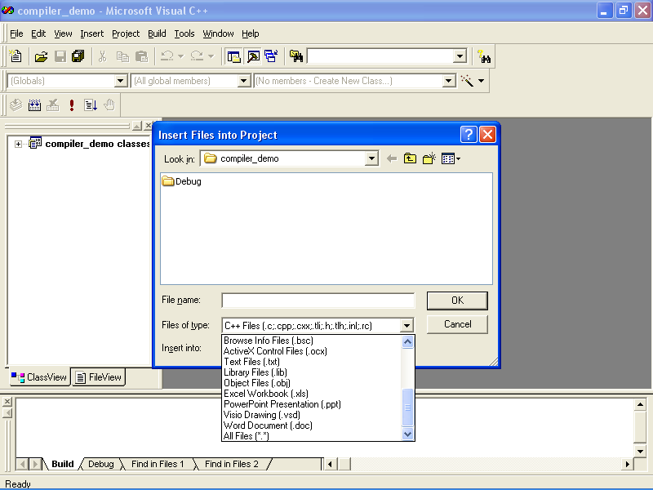

Slide 58
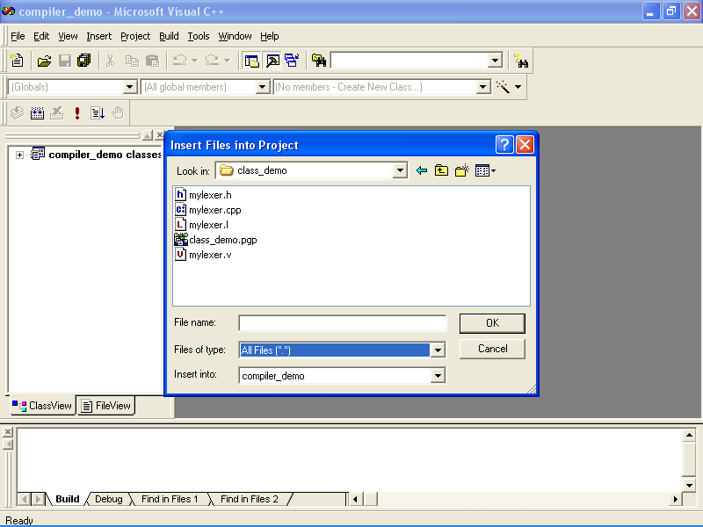

Slide 59
Select all the four files other than the one with an extension .pgp

Slide 60
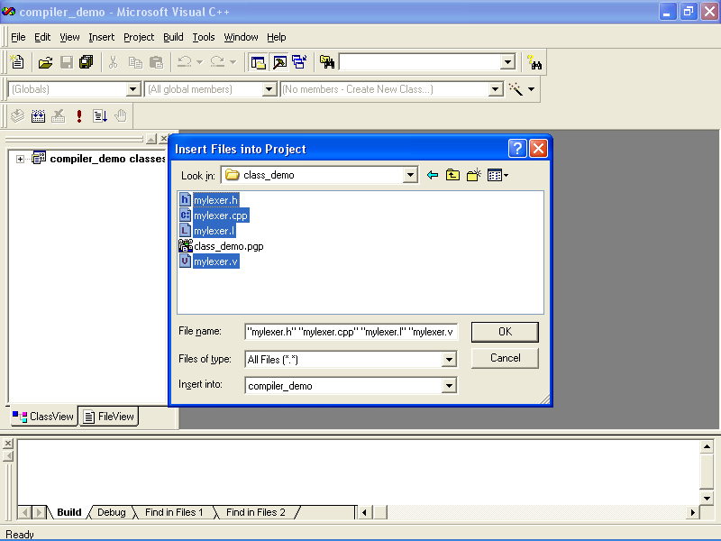

Slide 62


Slide 63
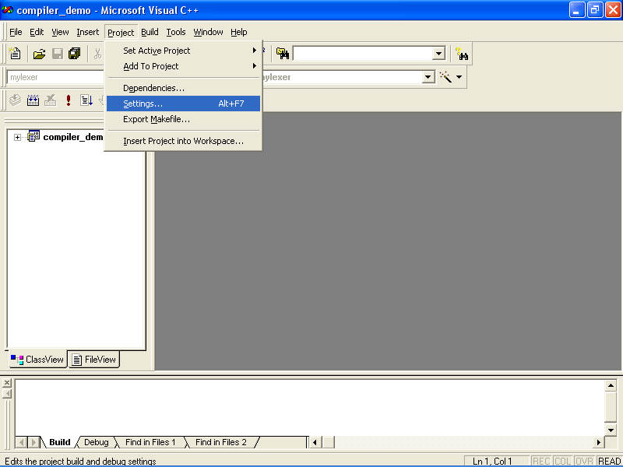

Slide 64
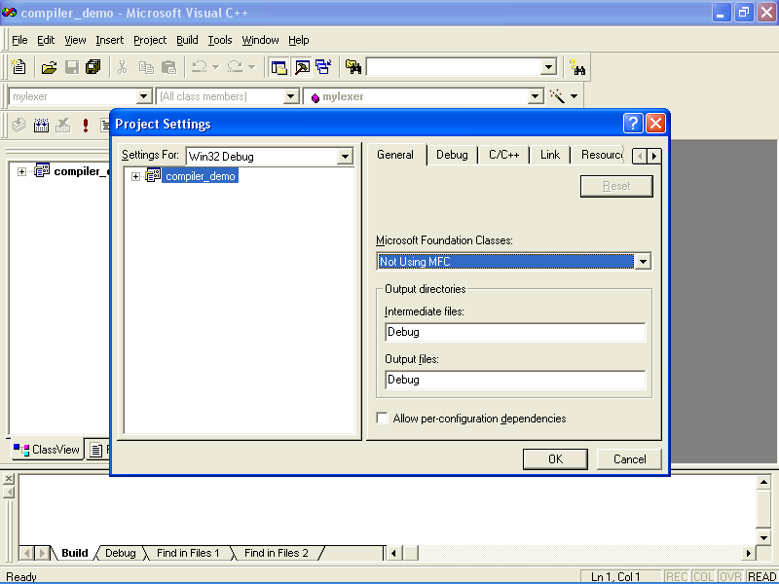

Slide 65


Slide 66


Slide 67


Slide 68
At the end of the list of names of “Object/library modules”, add: <space>yld.lib

Slide 69


Slide 70


Slide 71
At the end of the list of names of “Object/library modules”, add: <space>yl.lib

Slide 72


Slide 73


Slide 74


Slide 75


Slide 76


Slide 77
Execution of the program

Slide 78


Slide 79


Slide 80


Slide 81


Slide 82
Question ?????

